Slide 1
weekly report.
weekly report.
weekly report.
weekly report.
weekly report.
weekly report.
Aftersales
technical service.
Aftersales
technical service.
Aftersales
technical service.
Aftersales
technical service.
Aftersales
technical service.
Aftersales Technical Service 05/13/2019

Slide 2
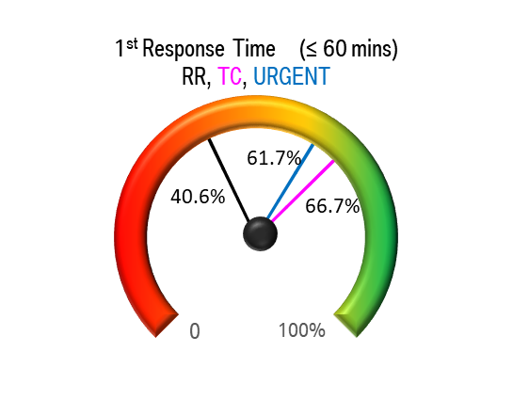
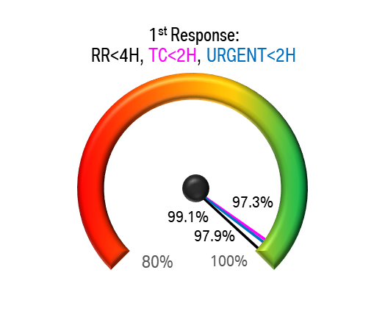
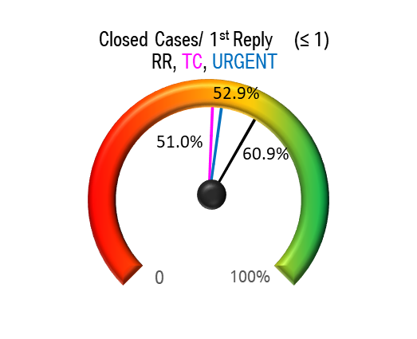
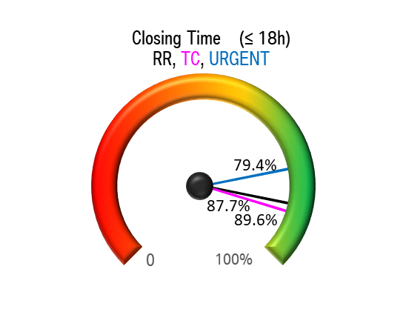
PuMA Case Status CW19.

Slide 3
PuMA Case Status CW19

Slide 4
Escalation email Status CW19.
 | PT | DT | EE | TT | Total
Unattended Emails | 0 | 0 | 1 | 0 | 1
Number of Emails sent out of work time | 8

Slide 5
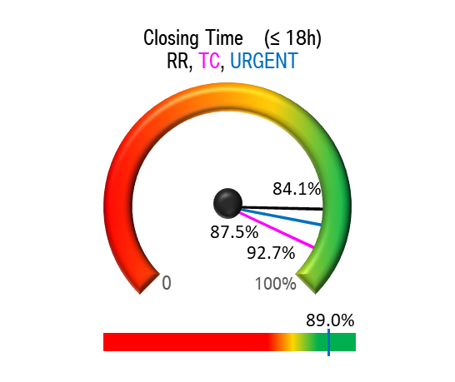
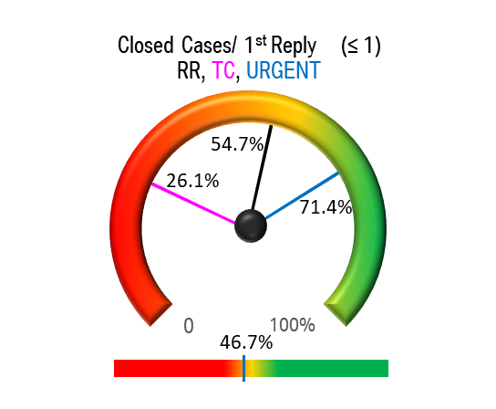
Puma Case Statistic – Pt

Slide 6

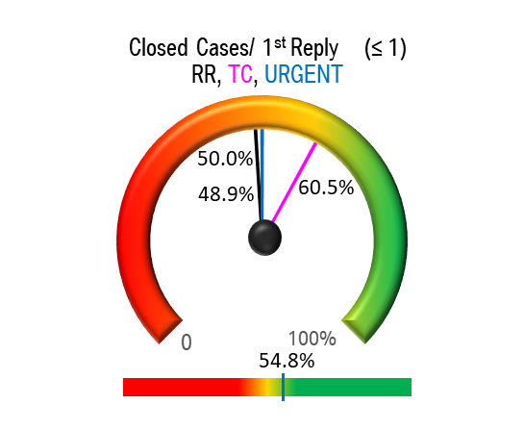
Puma Case Statistic – Dt

Slide 7
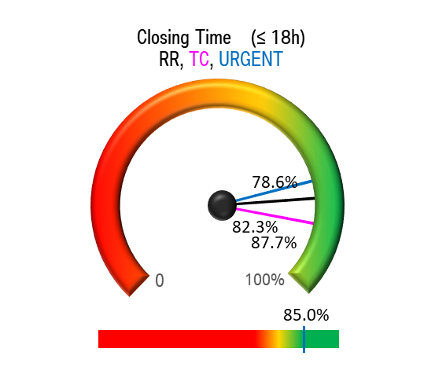
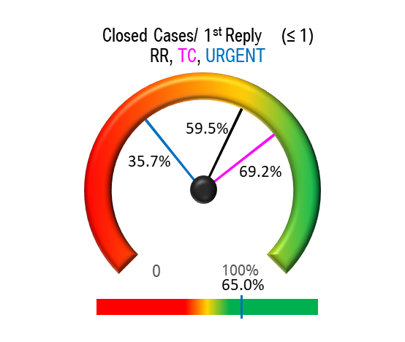
Puma Case Statistic – EE

Slide 8
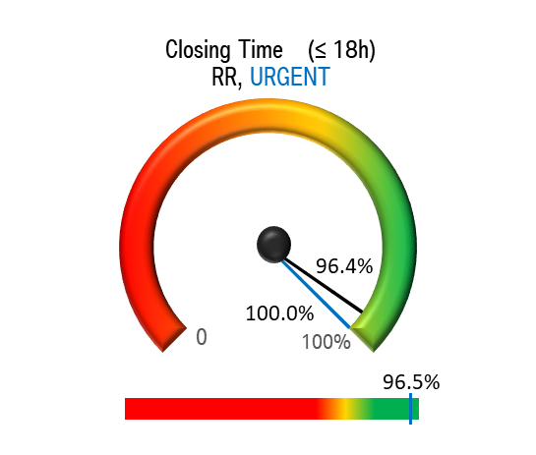
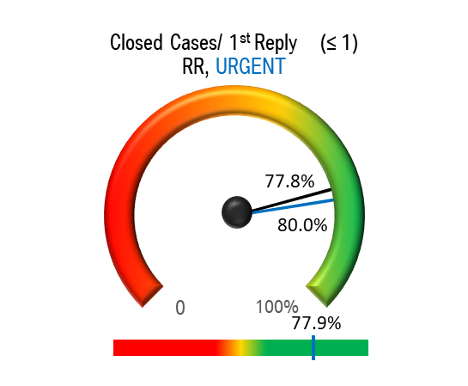
Puma Case Statistic – TT

